Slide 1
Ratio-Rite Grain Mixer
1602-21-735-072 – Arun Reddy karnati
1602-21-735-110 – Salma Anjum
1602-21-735-115 – Shivakalyan Gupta

Slide 2
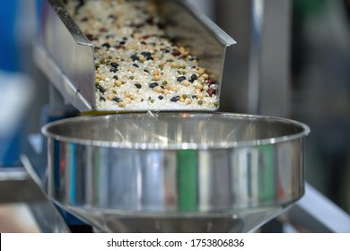
Introduction
What is grain mixer?
What it does?
Where it is used?
Is there any existing machine like this?
How is our approach different from the existing ones?
Notes:
Grain mixer is a machine that mixes two or more grains together evenly
What it does?
This takes n- types of grains in some fixed ratio r1:r2:r3:r4….. and mixes it in that particular ratio making sure that the total quantity doesn’t exceed the necessary total weight
Where it is used?
This is primarily used in rice milling industries in order to mix different types of grains together evenly in a certain ratio
For example: A traditional rice bag filled in a rice mill can have white rice, discolor ,broken rice ,frk rice in the ratio 71:3:25:1 which means for every 100 kgs of rice we can have 71 kgs of pure rice, 25 kgs of broken rice , 3 kgs of discolor and 1 kg of FRK rice
Is there any existing machine like this?
YES
How is our approach different from the existing ones?
The existing machines uses pneumatic system for the opening and closure of the chamber outlets and opening of chamber outlets which consumes lot of power and needs an extra maintenance
And also, its an additional investment to the industry
So we aim to eliminate this pneumatic system replacing it with stepper motors and precision controlled gear equipment

Slide 3
Problem statement
Design a cost and power efficient, precision grain blending machine

Slide 4
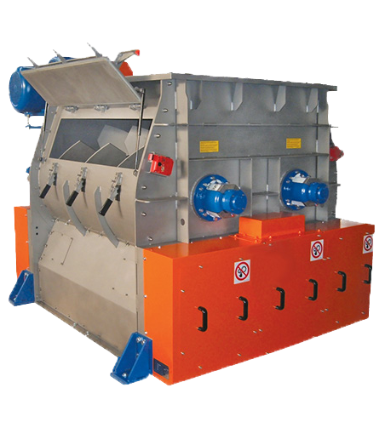
Motivation
To reduce the production and maintenance cost of grain mixing machine.
To increase the power efficiency of the grain mixing machine.
To device and provide a multipurpose machine, it can be used for FRK grain mixing, It can be used for multigrain Ata mixer, it can be used as a precise ratio grain mixer

Slide 5
Objectives
Calibrating and configuring a load sensor
Carving appropriate method to control the outlets
Designing a linear actuator
Integrating control mechanism with linear actuator
Programming necessary microcontrollers
Fabrication and assembly
Testing

Slide 6
Work flow
Decide upon hardware components
Calibrate necessary sensors
Test individual components
Design and test linear actuator
Integrate flow control mechanism
Program the microcontrollers
Assemble all the structures
Testing

Slide 7
Principle Adopted

Slide 8
Principle adopted
Precise Linear Motion with Rack and Pinion
Challenge: Achieve precise control over opening length for linear actuation.
Solution: Utilize a rack and pinion system driven by a 60 RPM DC geared motor.
Benefits:
Simple & Effective: A well-established mechanism for linear actuation.
Exceptional Control: Precise opening lengths achieved by manipulating motor run time.
How it Works:
Counting Teeth: The number of teeth on the pinion gear is crucial.
Timing Rotation: Time taken for a single pinion rotation is meticulously tracked.
Single Tooth Movement: This data is used to calculate the time required to move just one tooth.
Gears Translate Distance: Each tooth movement corresponds to a specific linear displacement of the rack.
Tailored Motor Run Time: By controlling motor operation duration, we dictate the exact number of teeth to move, achieving precise linear actuation.

Slide 9
Process
Set Ratio
Set the ratio of each mixture component
Total weight
Take the desired total weight, and based on ratio weight by each comp is decided
Dispense
Start dispensing grains at each compartment
Take Feedback
Once the grains are dispensed take the weight of dispensed grains as feedback from buffer
Adjust opening
Based on the feedback adjust the opening length
Mix all
Once all the buffers reach desired weight open all buffers into a funnel which mixes them all together

Slide 10
Components Used

Slide 11
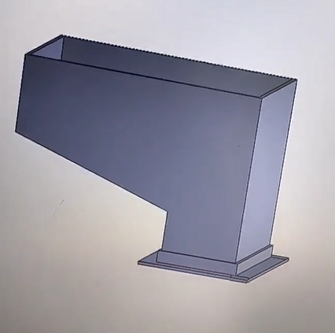
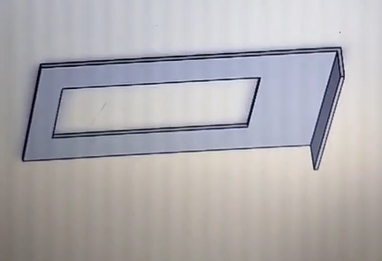
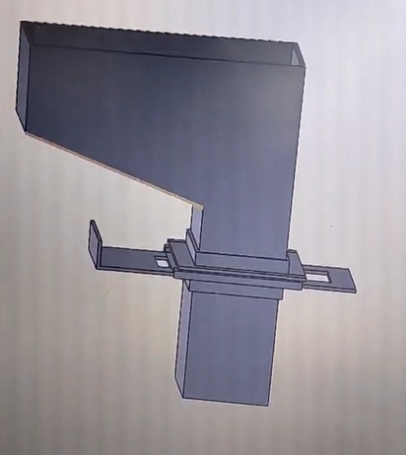
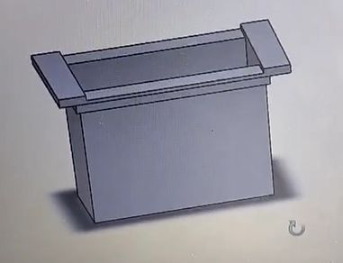
Components
Control gate
Hopper
Assembled version
Transition bin

Slide 12
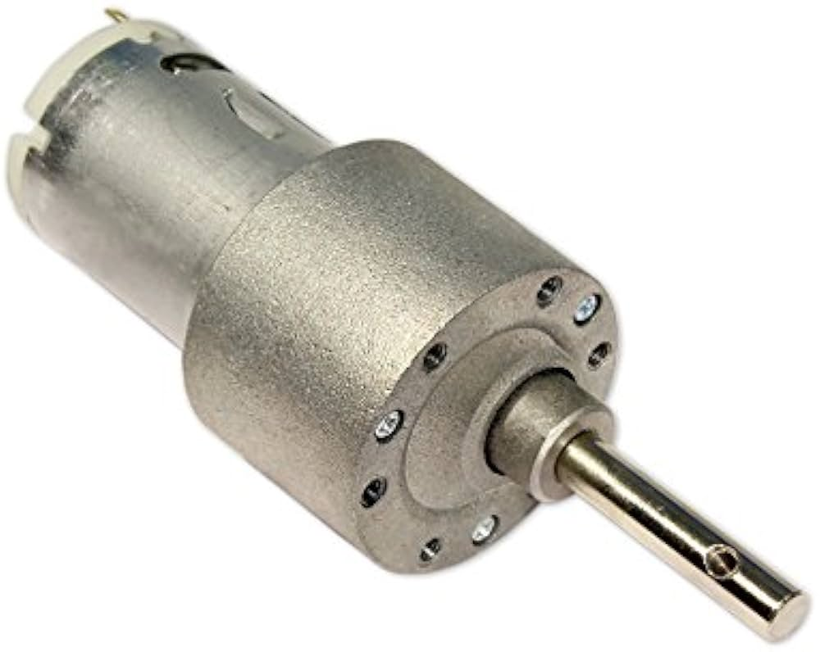
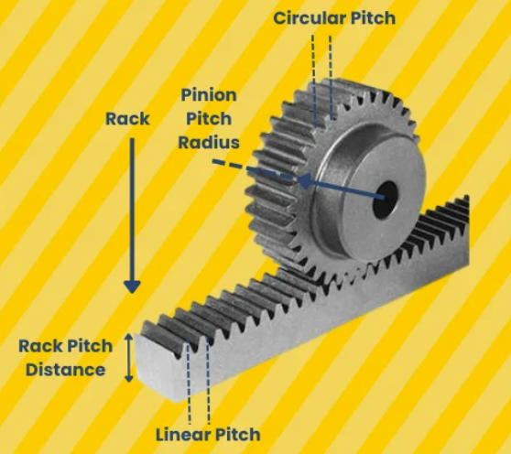
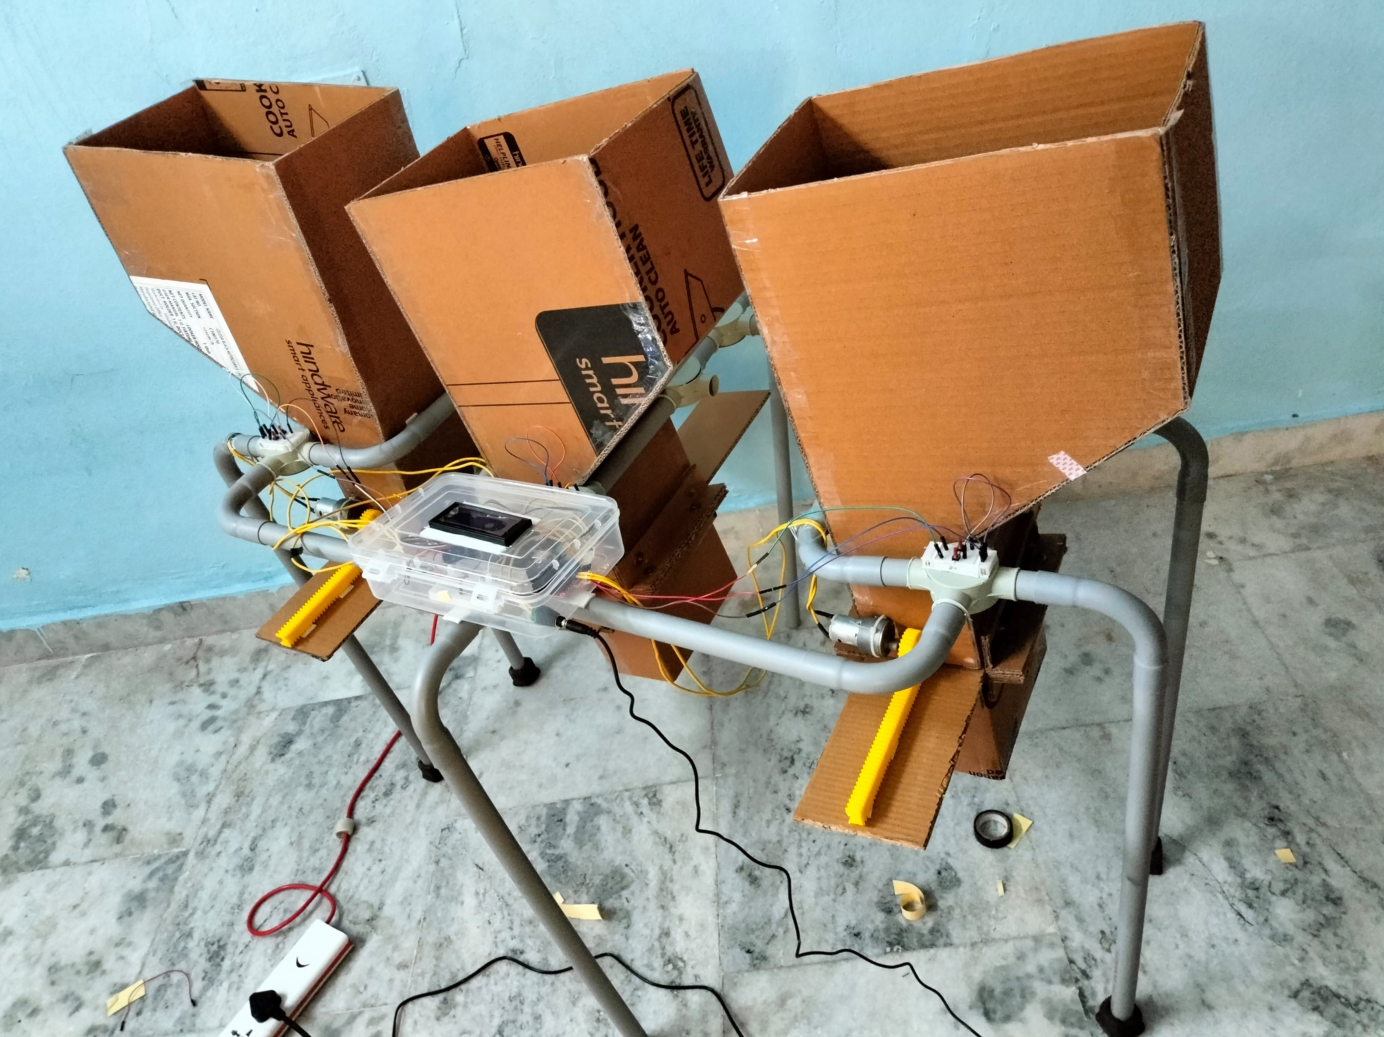
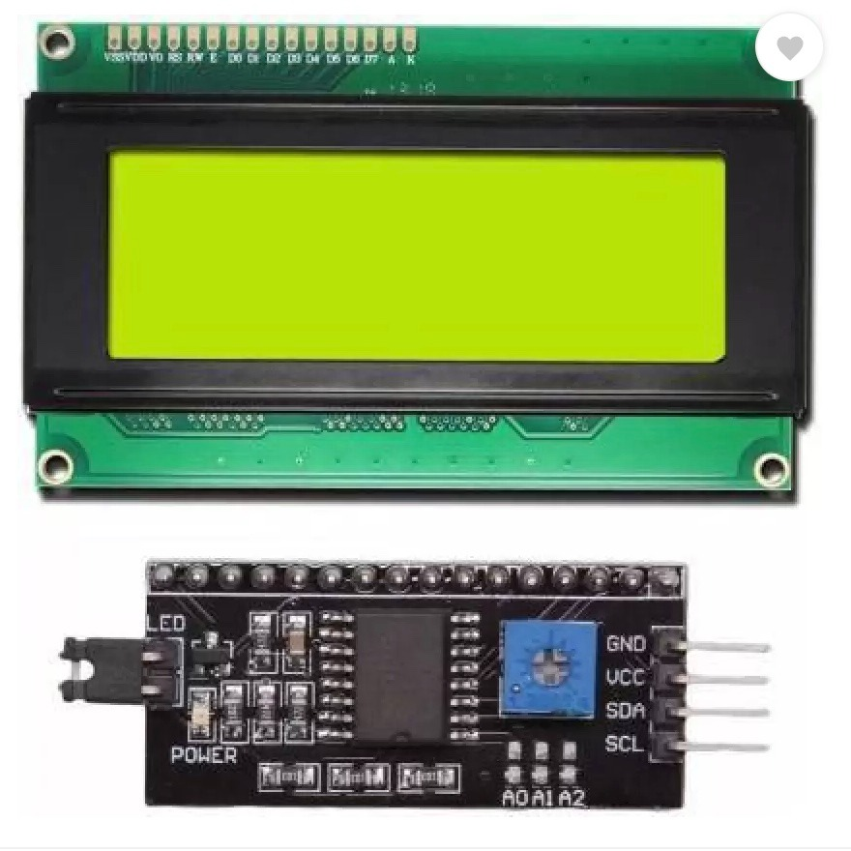
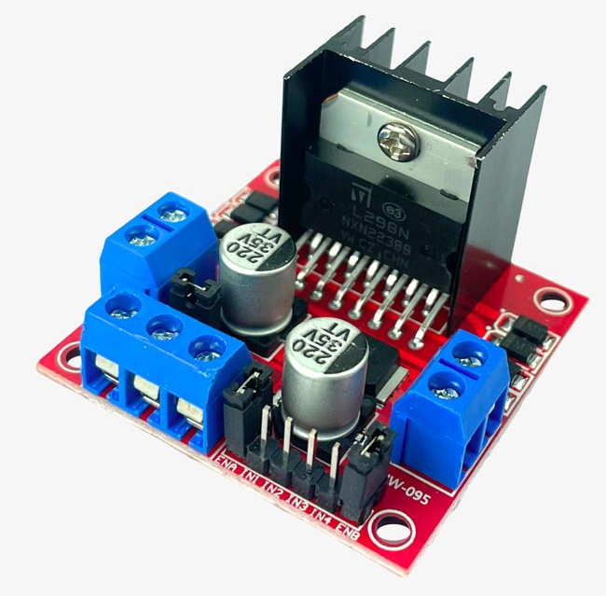
Components
Geared Dc motor 60 RPM
Rack and pinion
20x4 LCD with I2C
L298N

Slide 13
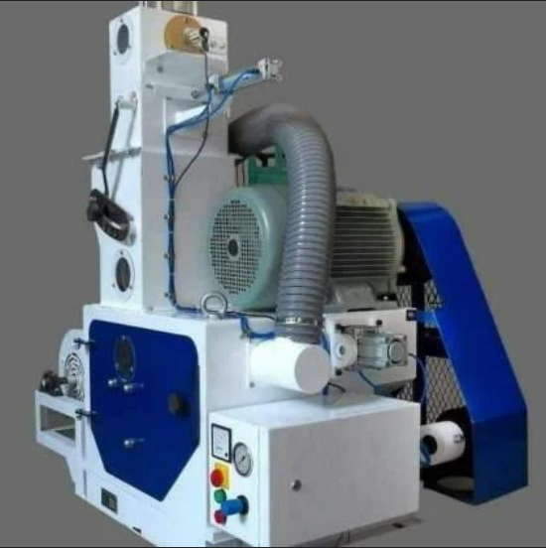
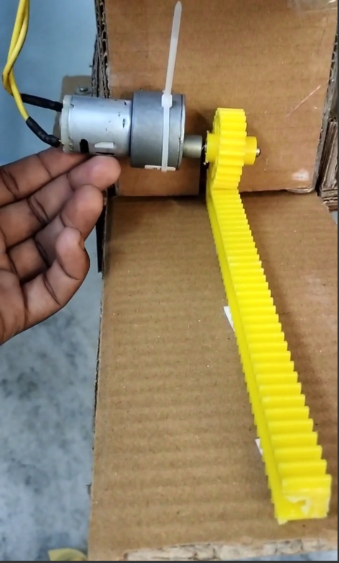
Components
Existing technology for controlled dispensing
New proposal

Slide 14
Challenges faced

Slide 15
Difficulties faced
Impact force for load sensor
The cardboard platform we used for testing wasn't suitable for the load sensors. The impact force caused the cardboard to dent, compromising the accuracy of the force measurements. Ideally, a metal platform would be needed to capture the impact force correctly.
Right positioning of motors
In our rack and pinion mechanism, the pinion requires continuous engagement with the rack. To achieve this, the motor driving the pinion needs precise positioning to ensure constant contact.

Slide 16
Difficulties faced
Vibration Transmission and Frame Instability
The frame designed to house all three modules in our project is experiencing an issue. Vibrations generated by one module are transmitting throughout the entire frame, leading to overall frame instability.
Data Acquisition Challenges
The current microcontroller's limited clock speed presents a challenge in capturing minute weight variations from the load sensor.

Slide 17
Mitigating Challenges

Slide 18
Mitigating Challenges
Impact force for load sensor
In order to overcome this issue as this is a prototype, we are using push buttons for each chamber which can be used to convey an “increase in dispensed weight” or “decrease in dispensed weight” signal to the MCU, which is similar to using the load sensor so that its behavior can be analyzed.
Right positioning of motors
To ensure continuous pinion-rack engagement, we employed small clamps (like zip ties) to apply gentle pressure.

Slide 19
Mitigating Challenges
Vibration Transmission and Frame Instability
The challenge of vibration transmission can be addressed by implementing separate frames for each module. This strategic design isolates vibration sources, promoting exceptional stability for the entire system
Data Acquisition Challenges
This we can eliminate by going for MCU’s with higher clock speeds

Slide 20
Results, Observations & Future scope

Slide 21
Observations
Feedback system
As the dispensed weight increases the system compares the dispensed weight with the target weight to be dispensed, based on the difference between them the opening length of the particular module is decided.
Double check
optical sensors(here Ir sensors) ensure that there are grains in the modules before the dispensing starts

Slide 22
Results
A linear actuator has been designed with the help of rack and pinion mechanism.
Microcontroller is programmed to ensure a proper connection between dispensed weight and the ratio to be maintained.
Controlled dispensing of the grains based on the target weights of respective modules has been achieved
Grain Ratio is maintained while dispensing the grains, through a proper feedback based dispensing system.

Slide 23
Future scope
We can plan and add an additional module which will take care of packing rice bags once the mixed rice is dispensed into them.
Quantity of rice packed can be provided to the user to track his or her output per day.
We can provide access to ratio control to the user’s mobile application.
We can gain more precise control on the dispensing mechanism through the linear actuator.
Notes:
We can gain more precise control either by increasing the number of gears on rack and pinionsor we can even shift towards the stepper motors for more accuracy

Slide 24


